Slide 1

Gardening
Merit Badge
Troop 344 and 9344
Pemberville, OH

Slide 2

Gardening Merit Badge Requirements
Do the following:
  Explain to your counselor the most likely hazards associated with gardening and what you should do to anticipate, help prevent, mitigate, and respond to these hazards.
  Discuss the prevention of and treatment for health concerns that could occur while gardening, including cuts, scratches, puncture wounds, insect bites, anaphylactic shock, heat reactions, and reactions from exposure to pesticides and fertilizers.
Do the following, and discuss your observations throughout the process with your counselor:
  Grow six vegetables, three from seeds and three from seedlings, through harvesting.
  Grow six flowers, three from seeds and three from seedlings, through flowering.
Give the nutritional value of the following:
  Three root or tuber crops.
  Three vegetables that bear above the ground.
  Three fruits.

Slide 3
Gardening Merit Badge Requirements
Test 100 garden seeds for germination. Determine the percentage of seeds that germinate. Explain why you think some did not germinate.
Visit your county extension agent’s office, local university, agricultural college, nursery, farm, or a botanical garden or arboretum. Report on what you learned.
Explain to your counselor how and why honeybees are used in pollinating food crops and the problems that face the bee population today. Discuss what the impact to humanity would be if there were no pollinators.
Identify five garden pests (insects, diseased plants). Recommend two solutions for each pest. At least one of the two solutions must be an organic method.

Slide 4
Gardening Merit Badge Requirements
Do ONE of the following and record weekly observations. Discuss the results of your project with your counselor:
  Build a compost bin and maintain it for 90 days.
  Build a vermipost bin (worm compost bin) and maintain it for 90 days.
  Build a hydroponic garden containing three vegetables or herbs, or three ornamental plants. Maintain this garden through harvest or flowering, or for 90 days.
  Build one water garden, either in a container (at least 12 by 6 inches and 6 inches deep), or in the ground as a small, decorative pond no larger than 6 by 3 feet and 24 inches deep. Maintain the water garden for 90 days.
  Prepare a honey super for use on a hive or colony. Remove a filled honey super from the hive or colony and prepare the honey for sale.
  Grow a garden of your own using soil from seed or plantings to harvest or for 90 days, whichever is earlier. This can be an outdoor garden or indoors using appropriate containers, and should include at least three types of plants approved by your counselor.

Slide 5

Gardening Merit Badge Requirements
Do ONE of the following:
  Identify three career opportunities that would use skills and knowledge in gardening. Pick one and research the training, education, certification requirements, experience, and expenses associated with entering the field. Research the prospects for employment, starting salary, advancement opportunities and career goals associated with this career. Discuss what you learned with your counselor and whether you might be interested in this career.
  Identify how you might use the skills and knowledge in gardening to pursue a personal hobby and/or healthy lifestyle. Research the additional training required, expenses, and affiliation with organizations that would help you maximize the enjoyment and benefit you might gain from it. Discuss what you learned with your counselor and share what short-term and long-term goals you might have if you pursued this.

Slide 6
Requirement 1
Do the following:
  Explain to your counselor the most likely hazards associated with gardening and what you should do to anticipate, help prevent, mitigate, and respond to these hazards.
  Discuss the prevention of and treatment for health concerns that could occur while gardening, including cuts, scratches, puncture wounds, insect bites, anaphylactic shock, heat reactions, and reactions from exposure to pesticides and fertilizers.

Slide 7
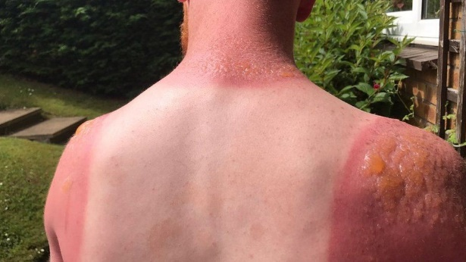
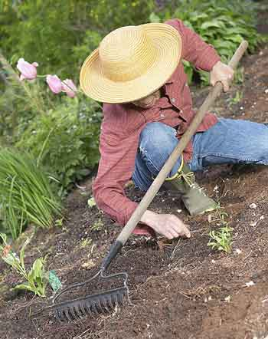
Hazards of Gardening
Sunburn and Heat Exhaustion
Extended sun exposure is bad for your skin. Protect areas like the back of your neck or your face. The heat can also cause dehydration and heat exhaustion if you are not careful.
Slather sunscreen (preferably SPF 30+) on before going out. You will sweat out the lotion while working so remember to re-apply every two hours.
Put on a hat, a long sleeved shirt and shades if you plan to garden for an extended period.
Stay in the shade when you can – Use an umbrella on days when the sun is really intense and shorten your gardening time.
Stay hydrated by drinking lots of water or other cold beverages but stay away from alcohol and caffeine. These drinks are diuretic and can cause dehydration.

Slide 8
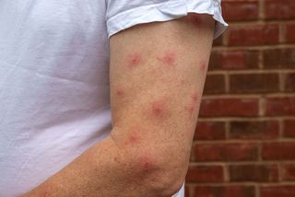
Hazards of Gardening
Insect bites
Tilling the soil and working with plants can expose you to nasty bugs.
Avoid ticks, which can be carriers of disease (among them Lyme disease).
Prevent bites by using insect repellent and covering your skin.
Tuck your pants into your socks and wear a hat.
Check yourself before going inside the house to make sure that you’re not carrying bugs and insects inside your home

Slide 9
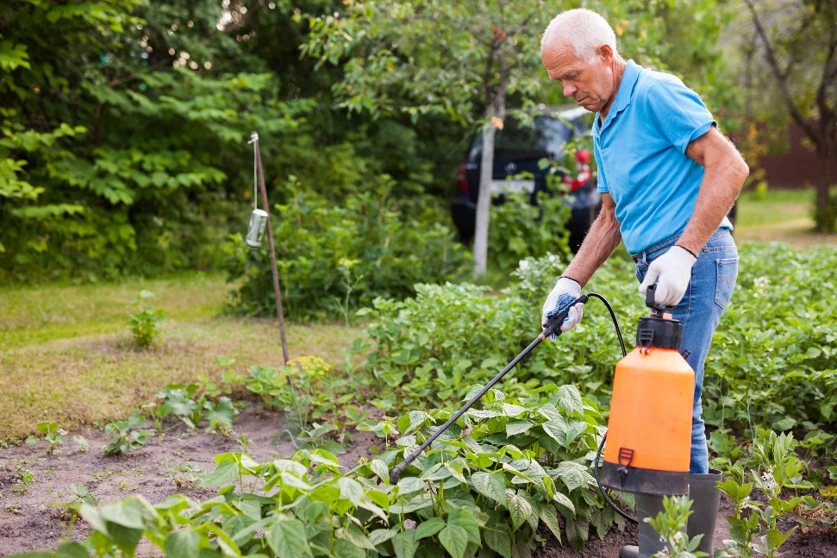
Hazards of Gardening
Poisonous chemicals
Be careful about using pesticides and fertilizers.
Ask advice from an expert at your local gardening center before using them or use organic mulches and fertilizers to be safe.
If you decide to use chemicals for your garden, follow instructions and warning labels.
Remember to keep pets and children away.

Slide 10
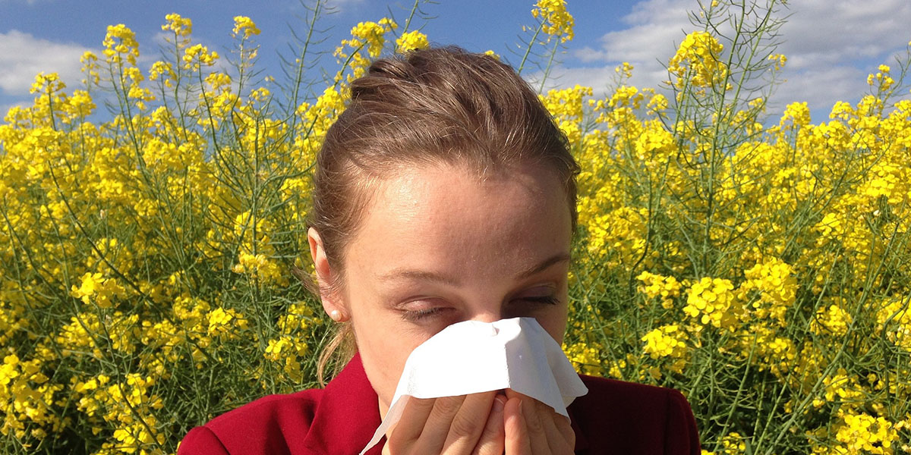
Hazards of Gardening
Allergies
Itchy eyes and occasional skin rashes are common, but if allergies get more serious, see a doctor. Allergies change over a lifetime, and they can react to seasonal growth patterns. So just because you weren't allergic to something last month doesn't mean you won't be this month.
Antihistamines such as Benadryl can reduce the effects of allergies.

Slide 11
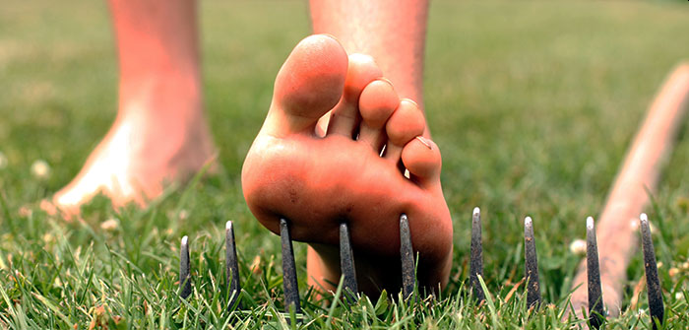
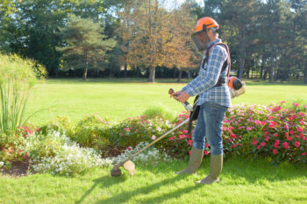
Hazards of Gardening
Cuts and scrapes
Cuts and scrapes can be caused by sharp gardening tools, thorny plants, rocks and soil debris. Always wear thick gloves to protect your hands, arms and shins. Consider updating your tetanus vaccine (recommended every 10 years) before you do intensive gardening work.
You can also damage your hearing through noisy machinery such as rototillers.
Using hearing protection, safety glasses, and protective clothing when using machinery, and good maintenance of tools and machines will reduce risk. It also helps to ensure there are no loose stones in areas where you are using mowers, weed-eaters and trimmers.

Slide 12
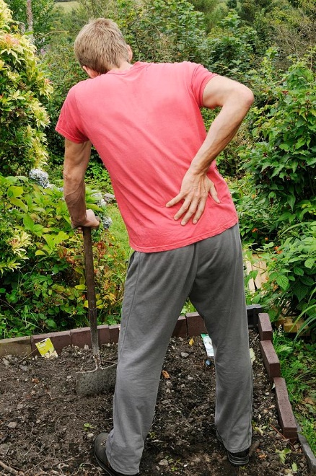
Hazards of Gardening
Back problems
Hours bent over tilling the soil or carrying heavy bags of mulch and other gardening materials can strain your back or cause damage to your spine. To prevent back problems, remember to:
  Use a portable garden or kneeling stool – This can protect your spine, knees and joints when you’re working close to the ground.
  Get a wheelbarrow – This will make moving heavy things around the garden easier. Ask for help if you need to load heavy things on your wheelbarrow, otherwise, divide the load into smaller, more manageable chunks. Load heavy things the right way. For example, bend your knees before lifting anything heavy.
  Take breaks – It’s very easy to overexert yourself when you’re enjoying gardening. This can lead to intense muscle and back pain later on. Doctors recommend getting up and stretching every 30-40 minutes. Drink some water, stay in the shade and let your muscles recover.
  Wear proper shoes – Wear shoes that have traction, are secure on your feet and have cushion and arch support. If the ground is slippery, wearing sandals or going barefoot can lead to a bad fall that can injure your back.

Slide 13
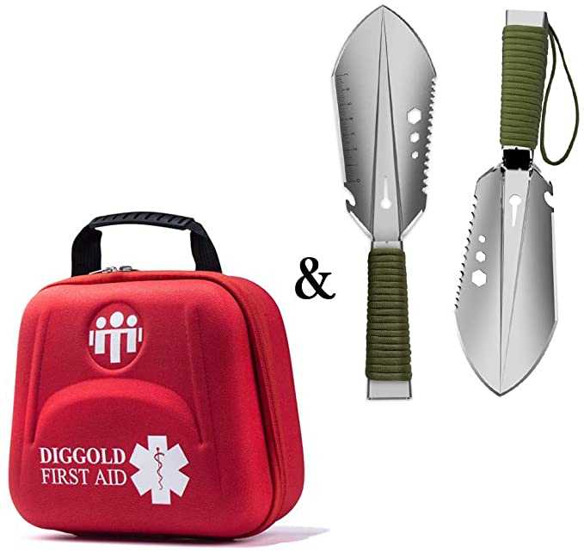
Requirement 1
Do the following:
  Explain to your counselor the most likely hazards associated with gardening and what you should do to anticipate, help prevent, mitigate, and respond to these hazards.
  Discuss the prevention of and treatment for health concerns that could occur while gardening, including cuts, scratches, puncture wounds, insect bites, anaphylactic shock, heat reactions, and reactions from exposure to pesticides and fertilizers.

Slide 14
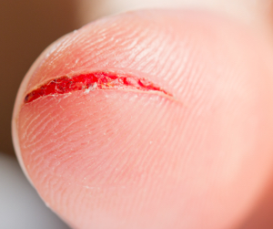
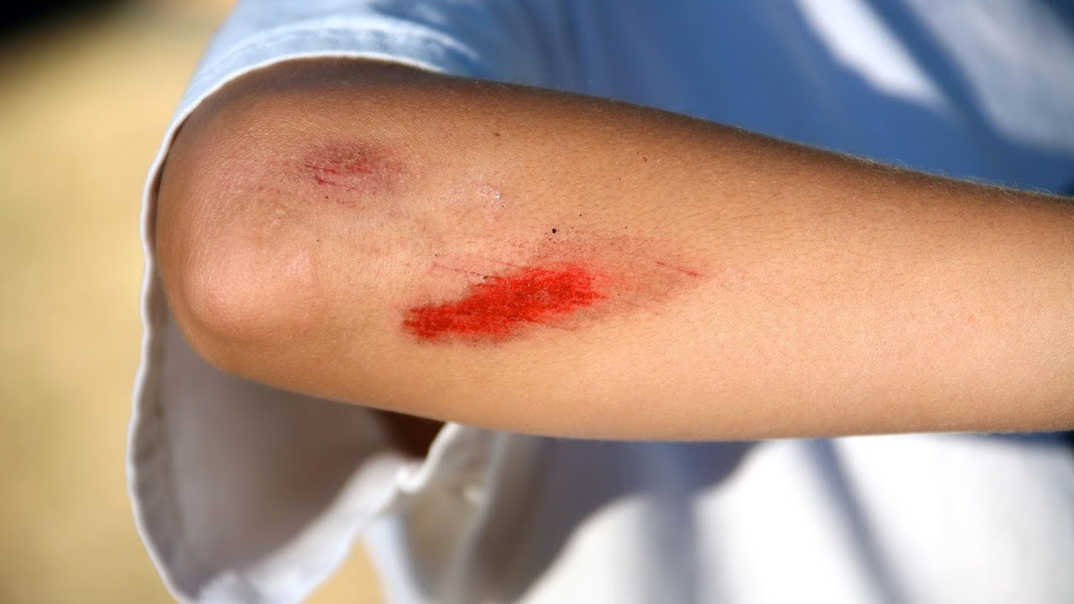
Simple Cuts and Scratches
Simple cuts are skin injuries caused by sharp objects.
  Usually not very deep
Scratches are areas of damage to the upper layers of skin.

Slide 15

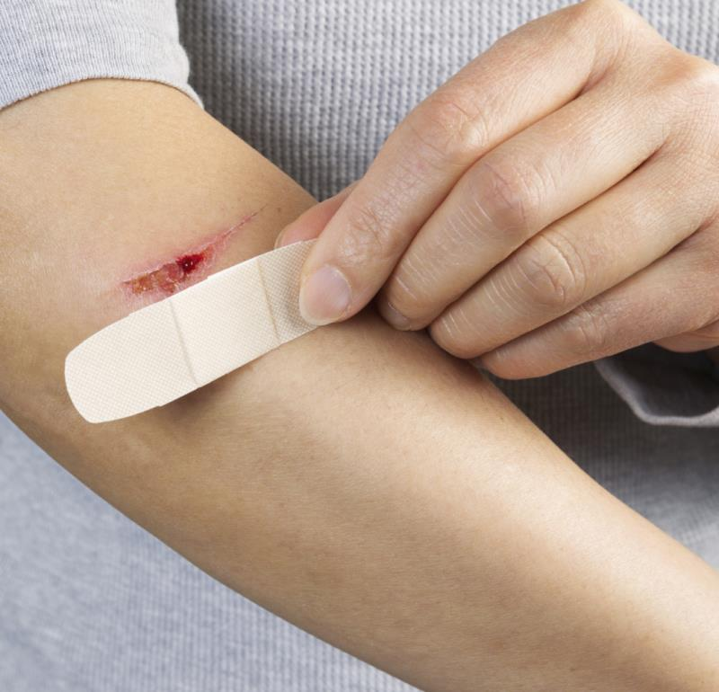
Treatment for Cuts and Scratches
Wash the wound with soap and water for 5 minutes.
  Remove any bits of dirt, small pieces of rock, or other debris.
Apply an antibiotic ointment such as Neosporin and cover it with a Band-Aid or gauze.

Slide 16
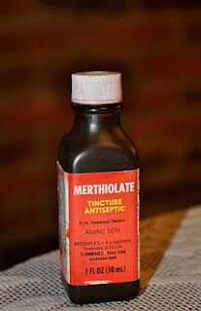
Common Mistakes in Treating Cuts and Scratches
  Don't use alcohol or Merthiolate on open wounds. They sting and damage normal tissue.
  Don't kiss an open wound because the wound will become contaminated by the many germs in a person's mouth. No kissing the Boo Boo!
  Let the scab fall off by itself; picking it off may cause a scar.

Slide 17
Puncture Wounds
Puncture wound first aid:
  Wash your hands. This helps prevent infection.
  Stop the bleeding by applying gentle pressure with a clean bandage or cloth.
  Clean the wound thoroughly.
  Apply an antibiotic (Neosporin). For the first two days, rewash the area and reapply the antibiotic when you change the dressing.
  Cover the wound with a bandage.
  Change the dressing daily or whenever the bandage becomes wet or dirty.
  Watch for signs of infection and see a doctor if the wound isn't healing or you notice any spreading redness, increasing pain, pus, swelling or fever.

Slide 18
Insect Bites
Bites of mosquitoes, chiggers (harvest mites), fleas, and bedbugs usually cause itchy, red bumps. The size of the swelling can vary from a dot to a half inch.
Signs that a bite is from a mosquito are: itchiness, a central raised dot in the swelling, a bite on skin not covered by clothing, and summertime,
Fleas and bedbugs tend to bite skin under clothing. Flea bites often turn into little blisters in young children.
Bites from horseflies, deerflies, gnats, fire ants, harvester ants, blister beetles, and centipedes usually cause a painful, red bump. Fire ant bites change to blisters or pimples within a few hours.

Slide 19
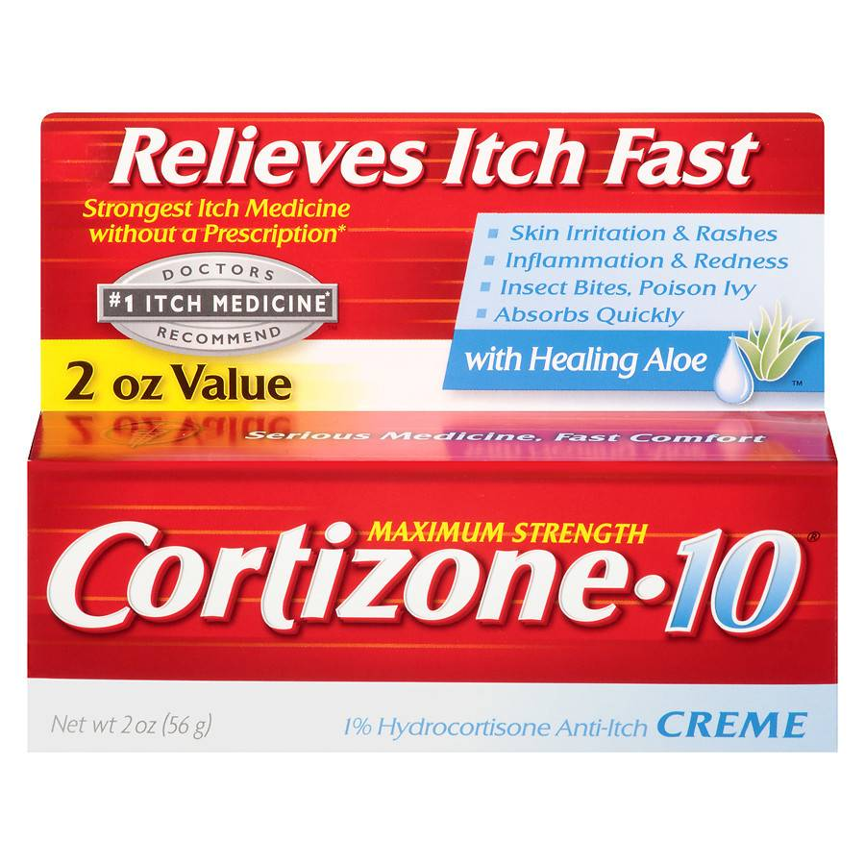
Treatment of Insect Bites
Apply calamine lotion or a baking soda paste to the area of the bite.
If the itch is severe (as with chiggers), apply nonprescription 1% hydrocortisone cream four times a day.
Do not to pick at the bites or they can become infected or leave scars.
Cold, moist compresses or ice on the area can help.

Slide 20
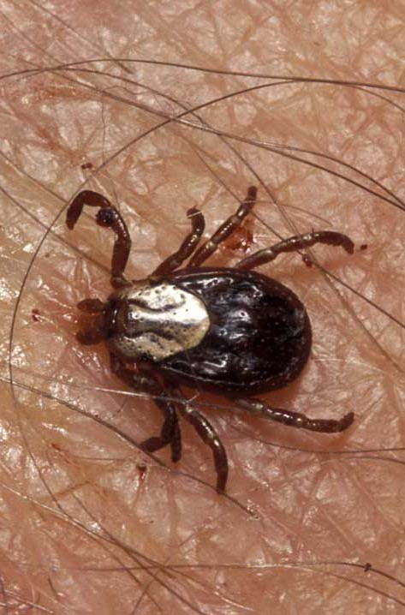
Tick Bites
Can transmit Rocky Mountain spotted fever or Lyme disease
Tick embeds it’s mouth parts in skin and may remain for days sucking blood.

Slide 21
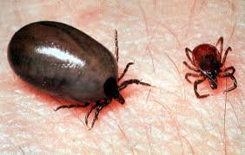
Engorged Tick

Slide 22
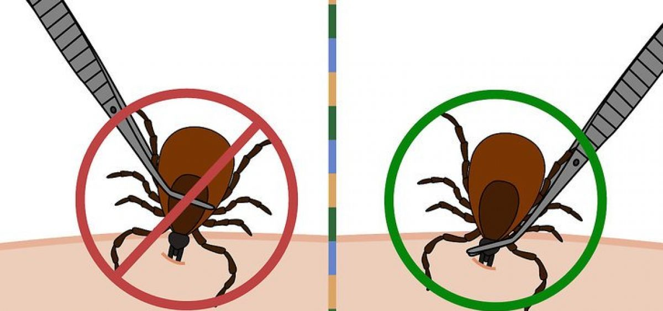
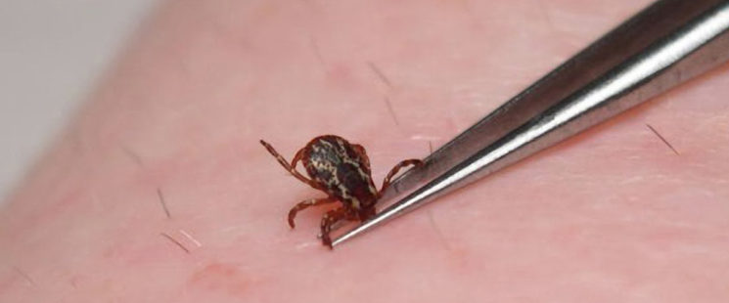
Tick Removal
Grasp the tick’s mouthparts against the skin, using pointed tweezers.
Pull steadily without twisting until you can ease the tick head straight out of the skin.
DO NOT squeeze or crush the body of the tick.
DO NOT apply substances such as petroleum jelly, nail polish, or a lighted match to the tick while it is attached.

Slide 23
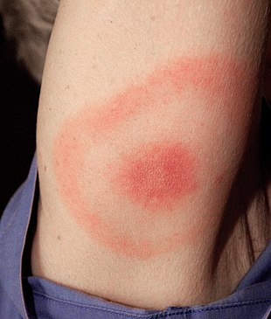
Tick Removal Cont.
Once you have removed the tick, wash the wound site and your hands with soap and water, and apply rubbing alcohol or antiseptic to the site.
Observe the bite over the next two weeks for any signs of an expanding red rash or flu-like symptoms (Lyme Disease).
Lyme Disease Rash

Slide 24
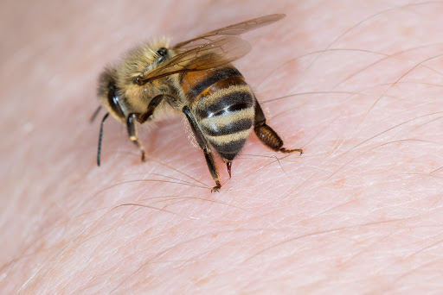
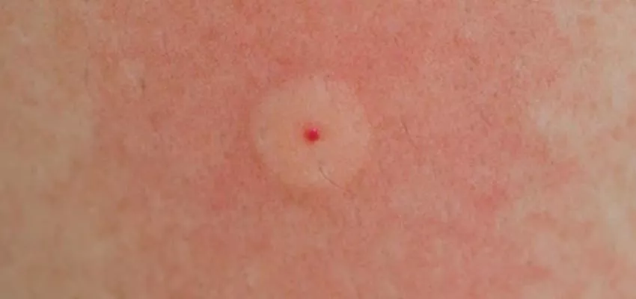
Bee Stings
Honey bees, bumble bees, hornets, wasps, and yellow jackets can all sting.
These stings cause immediate painful red bumps.
While the pain is usually better in 2 hours, the swelling may increase for up to 24 hours.

Slide 25
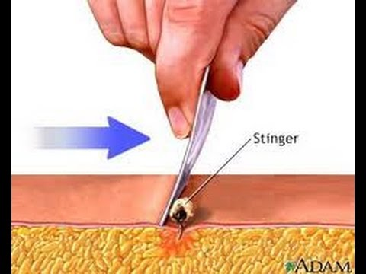
Treatment of stings
If you see a little black dot in the bite, the stinger is still present (this only occurs with honey bee stings).
Remove it by scraping it off with a credit card or something similar.
For persistent pain, massage with an ice cube for 10 minutes.
Give acetaminophen immediately for relief of pain and burning.
For itching, apply hydrocortisone cream.

Slide 26
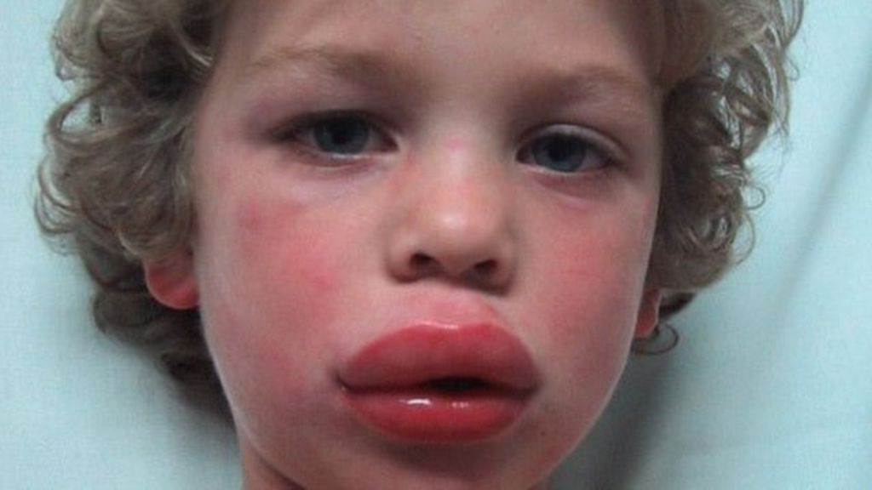
Symptoms of Allergic Reactions
Difficulty breathing, wheezing.
Tightness in throat or chest.
Swelling of the face and neck, puffy eyes.

Slide 27
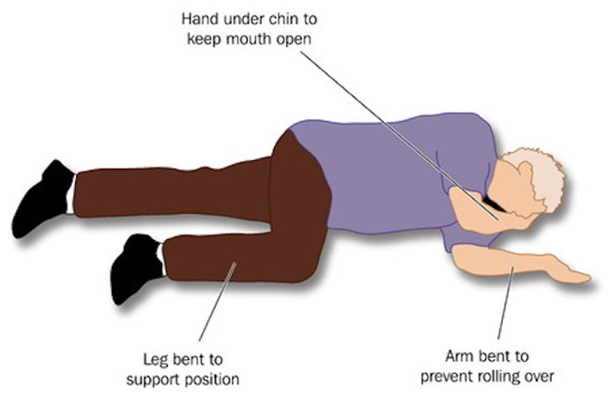
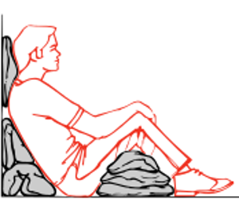
First Aid for Anaphylaxis
(Severe Allergic Reactions)
Call 911.
Lay person flat – do not allow them to stand or walk.
  If unconscious, place in recovery position.
  If breathing is difficult allow them to sit up.
Give adrenaline autoinjector (EpiPen).
Monitor the victim’s breathing and be prepared to give CPR.

Slide 28
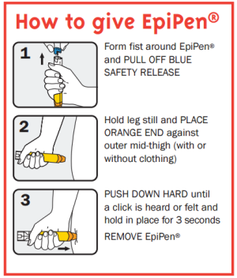
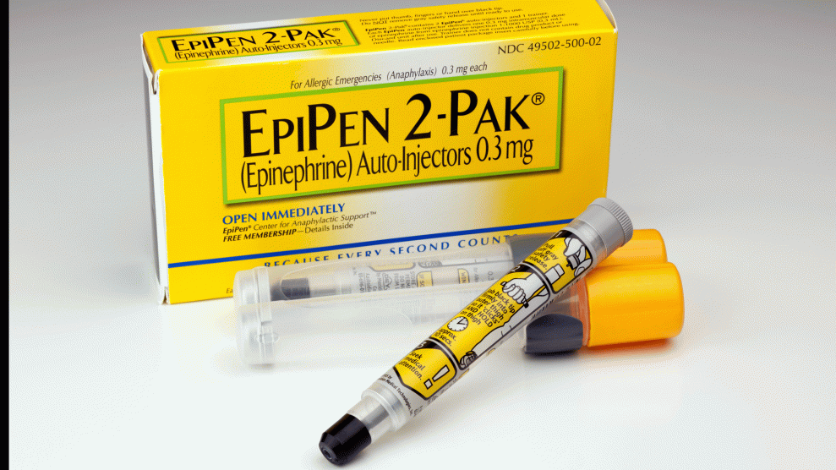
First Aid for Anaphylaxis
(Severe Allergic Reactions)
Emergency Epinephrine Kit (EpiPen)
May be carried by people with severe allergies.
Help the victim open and use the kit as needed.

Slide 29

Dehydration
When the body puts out more liquid than it is taking in.
Ways we lose fluids:
  Sweating.
  Urination.
  Vomiting.
Signs of dehydration:
  Thirst.
  Yellow or dark urine.
  Dry mouth.
  Lightheadedness.
  Nausea and vomiting.
  Dry skin.
  Cease sweating.
Treatment:
  Drink fluids (water, Gatorade).
  Avoid physical activity.
  Get inside air conditioned or cool area.

Slide 30
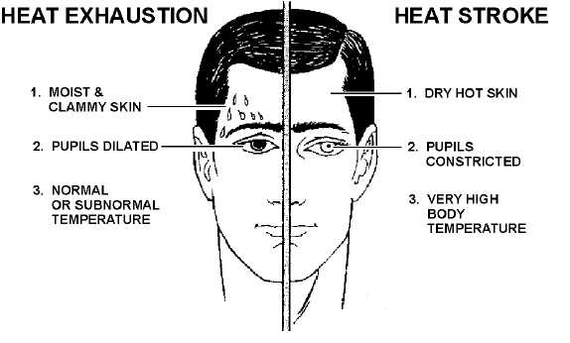
Heat Emergencies

Slide 31

Heat Exhaustion Symptoms
Heavy sweating
Thirst
Fatigue
Heat cramps
Headache
Dizziness
Nausea
Vomiting

Slide 32

First Aid for Heat Exhaustion
Move victim from heat to rest in a cool place.
Loosen or remove unnecessary clothing.
Give water or a sports drink.
Raise feet 8-12 inches.
Put cool, wet cloths on forehead and body – spray skin with water.
Seek medical care if victim’s condition worsens or does not improve within 30 minutes.

Slide 33
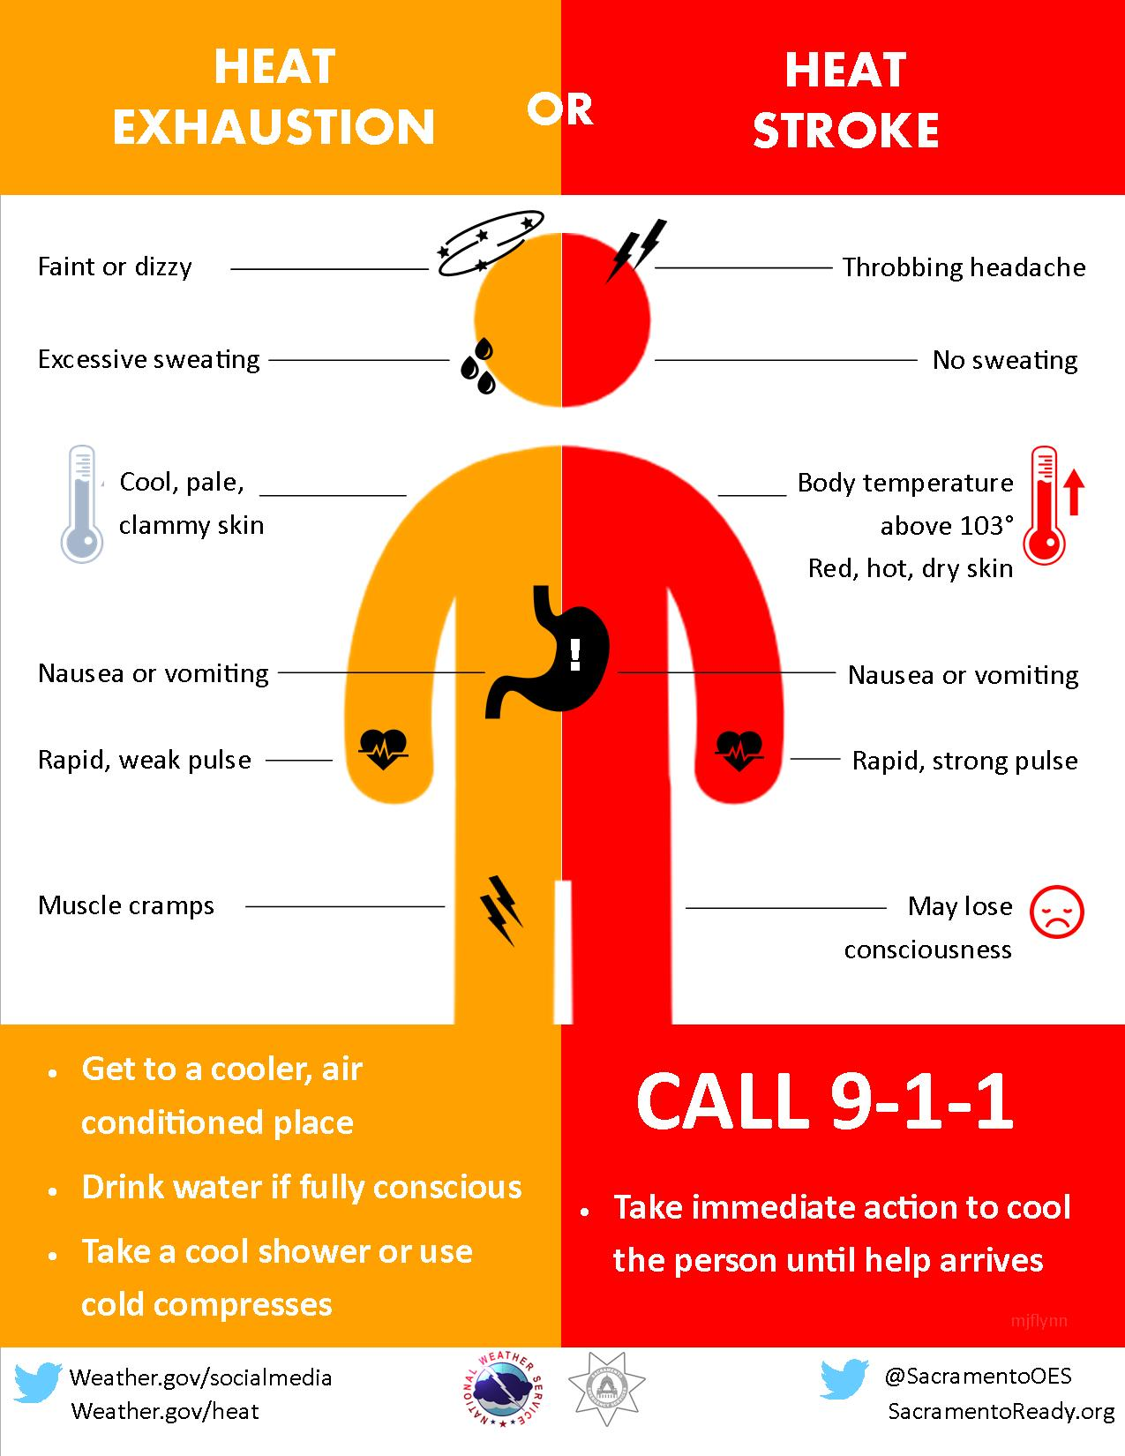
Heatstroke

Slide 34
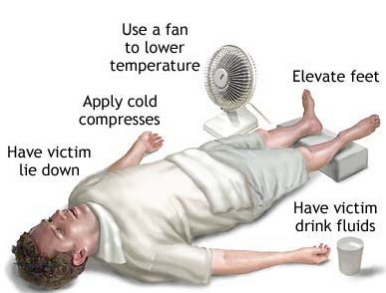
First Aid for Heat Stroke
Call 911.
Move victim to cool place.
Remove outer clothing.
Cool victim quickly.
Apply cold compresses or spray skin with water.
Put ice bags or cold packs beside neck, armpits, and groin.

Slide 35
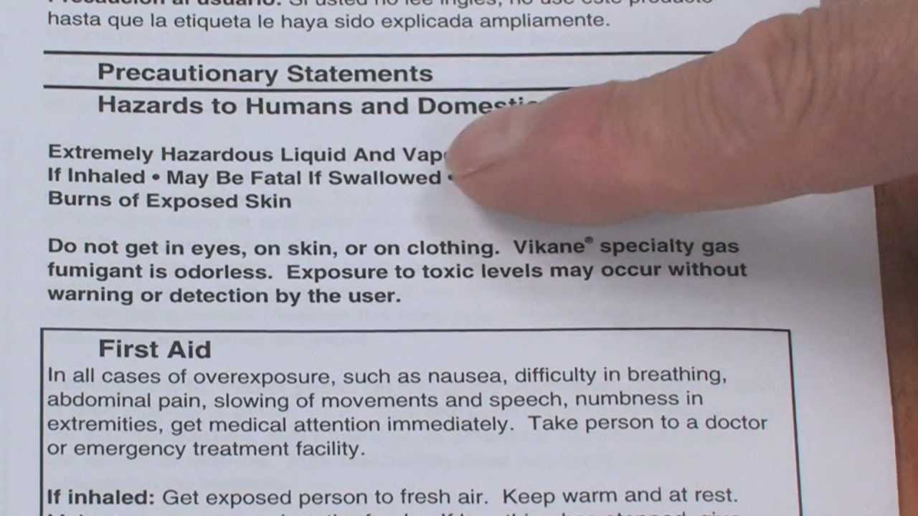
First Aid for Pesticide Exposure
If someone has swallowed or inhaled a pesticide or gotten it in the eyes or on the skin:
Call 911 if the person is unconscious, having trouble breathing or having convulsions.
Check the label for directions on first aid for that product.
Call the Poison Control Center at (800) 222-1222 for help with first aid information.

Slide 36
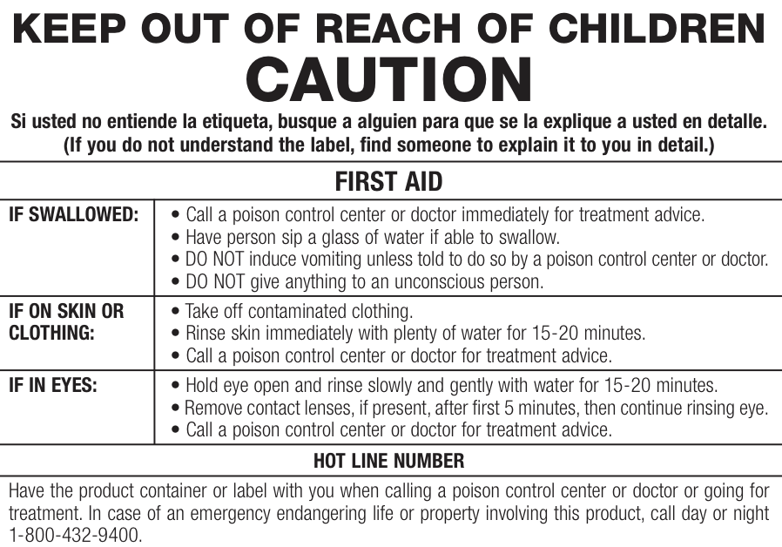
First Aid for Pesticide Exposure

Slide 37
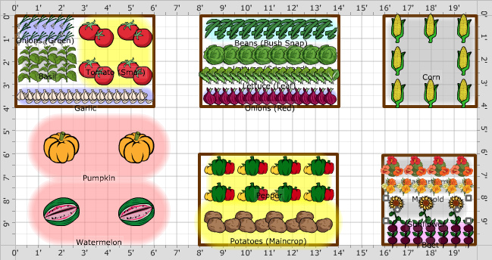
Requirement 2
Do the following, and discuss your observations throughout the process with your counselor:
  Grow six vegetables, three from seeds and three from seedlings, through harvesting.
  Grow six flowers, three from seeds and three from seedlings, through flowering.

Slide 38
Gardening
To be a good gardener, you will need to understand the science of growing plants
  How to prepare the soil.
  How to select and plant seeds.
  How to care for growing plants.
Most vegetables and fruits grow best in full sunlight.
You will need to decide whether to grow your garden in the ground or in containers.
Before you plan your garden, find out about the agricultural region where you live.
  Knowing the region in which your garden is located will help you select the right types of plants to grow.

Slide 39
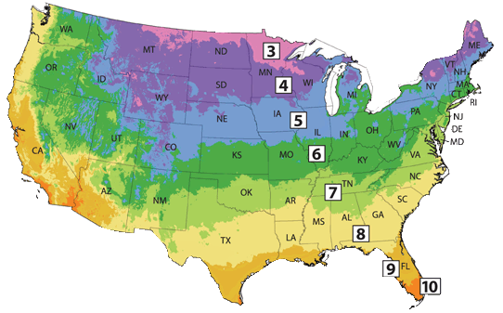
Growing Regions of the U.S.

Slide 40
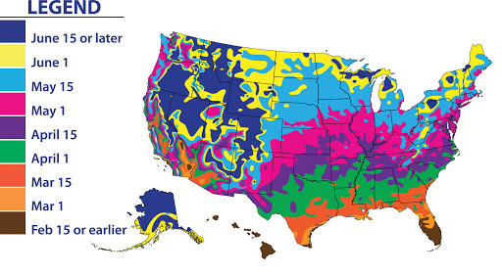
Average Last Frost Date Map
Average frost dates are one of the most important dates every gardener should know.
Different plants vary in hardiness and ability to withstand frost and cold temperatures.
It's best not to sow seeds or plant seedlings of tender, heat-loving plants, such as Tomatoes, Cosmos or Basil, before the average date of the last spring frost unless you are ready to provide protection.
Some plants like cool-season annuals and vegetables, such as Pansy, Stock, Snapdragon, Broccoli or Peas, can withstand frost and can be planted as much as 6 weeks before the average date of the last frost in spring, often as soon as the soil can be worked.

Slide 41
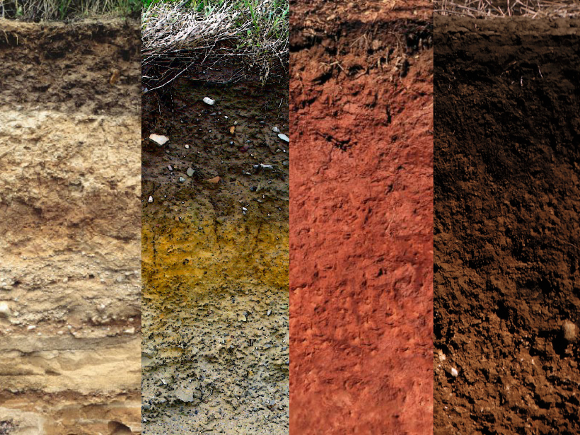
Soils
The earth in which plants grow is called soil.
The upper layers of soil are usually made up of decaying plant material such as leaves, mulch, and grass clippings.
The lower layers of soil are made up of rocks and minerals that have crumbled with age and wear.
Rain, earthworms, fungi, and bacteria help the upper layers break down.
When the upper and lower layers combine, soil is formed.
Sometimes a gardener may need to help the layers mix and this is called tilling or turning the soil.
Some kinds of soil contain materials that are better for garden plots, and some kinds of plants grow only in certain kinds of soil.

Slide 42
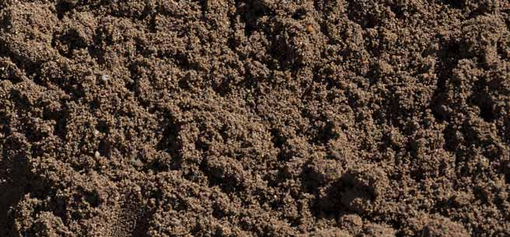
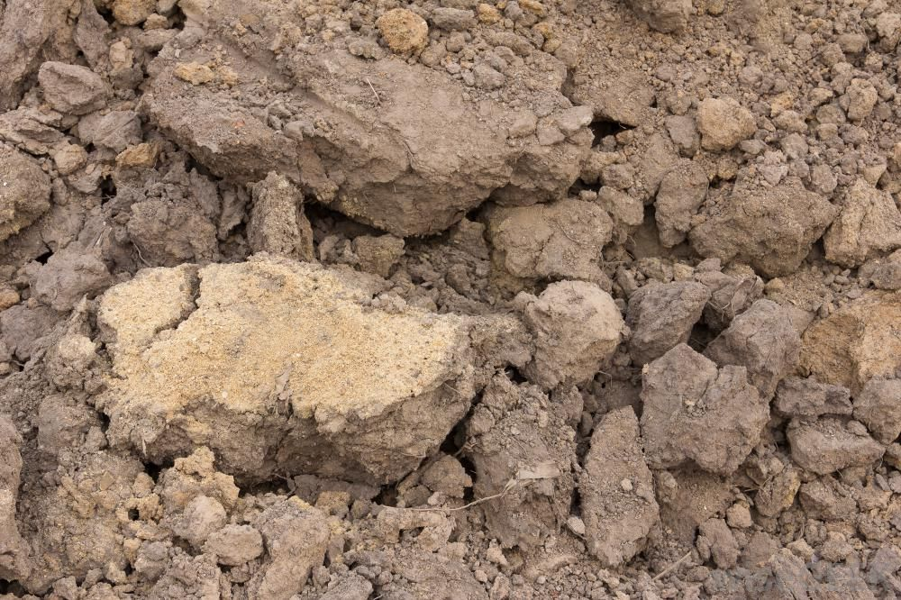
Types of Soils
Sandy Loam Soil:
  It contains a good mixture of sand and decaying material and is good for most plants to grow.
  If there is too much sand, you will need to add organic humus or compost to keep it from drying out too quickly.
Clay Loam Soil:
  Is a heavy soil and makes gardening difficult. It dries out slowly and sometimes forms a crust on top.
  Clay is not good for gardening unless you add sand and organic matter, such as compost, to make it easier for plant roots to grow and water to drain.

Slide 43
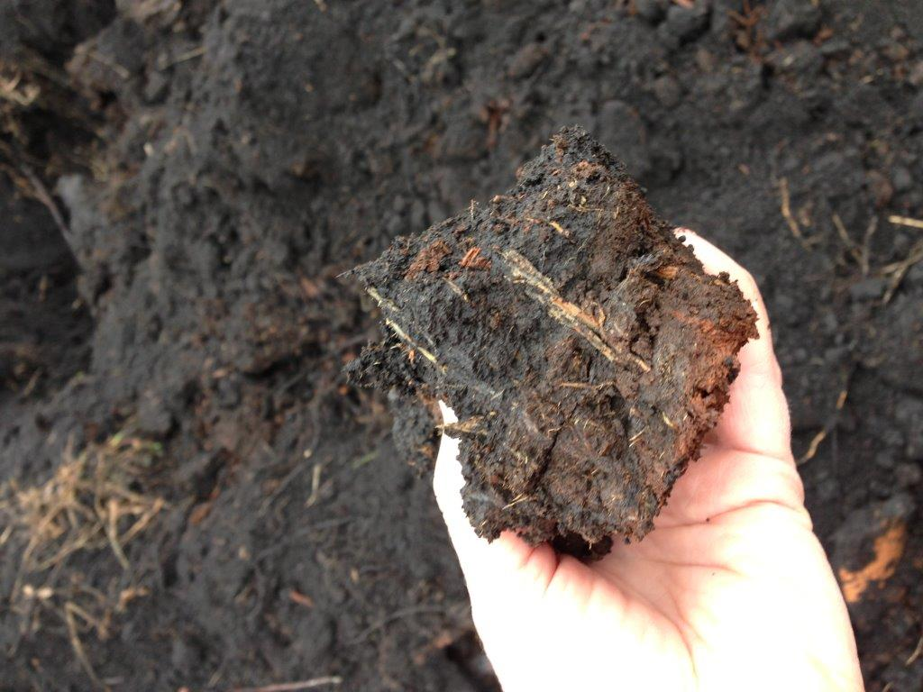
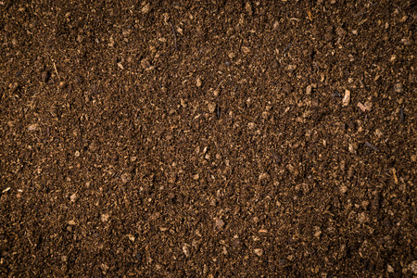
Types of Soils
Mucky Soil:
  Is dark, rich in nutrients, and very good for growing many different kinds of vegetables.
  The nutrients from decaying organic material provide a lot of food for plants.
  If the mucky soil in your garden does not drain well, add sand and then till the plot before planting.
Peat Soil:
  Contains decaying vegetable matter, usually from a forest floor, that is high in carbon.
  Carbon is a nutrient that helps plants grow.
  Peat soil is light and almost dusty.
  If your garden area contains only peat, add topsoil, organic humus, or compost, and then till the plot before planting.

Slide 44
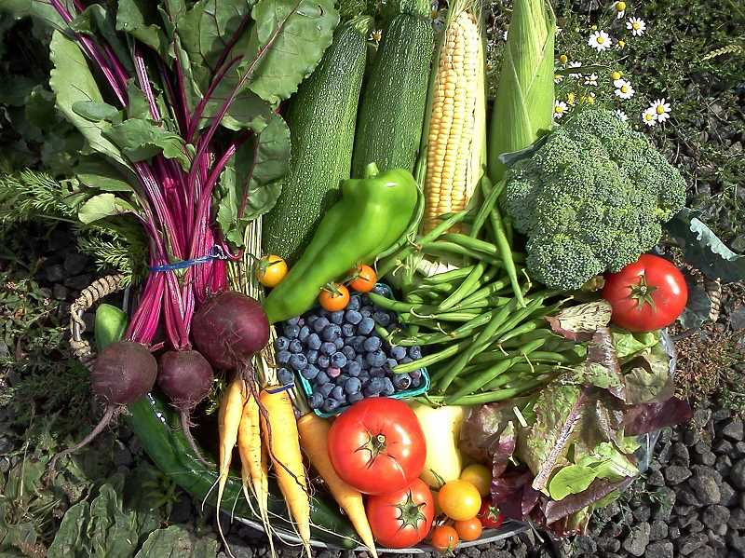
Planning Your Garden
Before you plant your garden, decide what crops you want to grow.
Step 1: What Vegetables Do You Like?
Step 2: What Vegetables Do You Eat Regularly?
Step 3: Review Those Lists
  Read through both of your lists and highlight the vegetables which appear on both lists. It is those vegetables you should focus on trying to grow first.

Slide 45
Planning Your Garden
Step 4: Decide where to grow the garden.
Step 5: Get a piece of paper and a pencil and map out where you will plant each crop.
  If you are a new gardener, try to limit the number of plants and varieties you are planting in order to keep your garden manageable while you are learning.
  Limit the number of plants based on the space you intend to plant in.

Slide 46
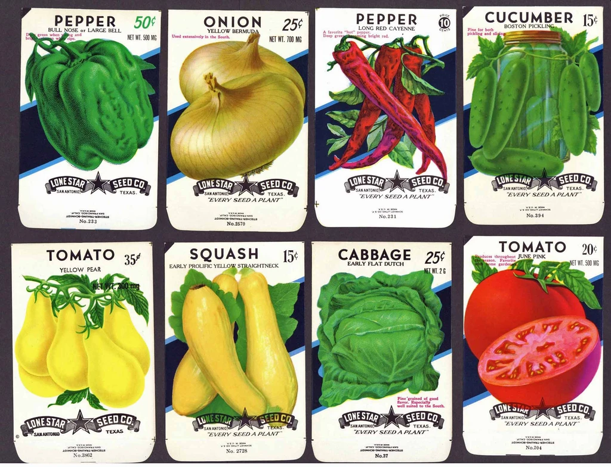
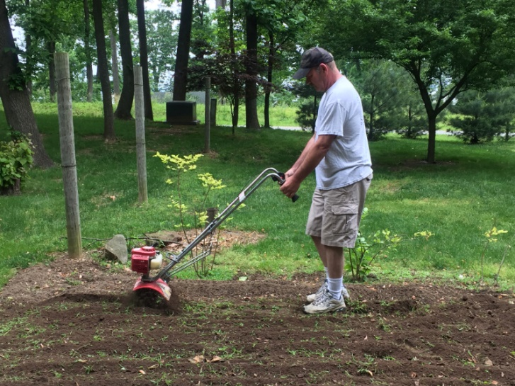
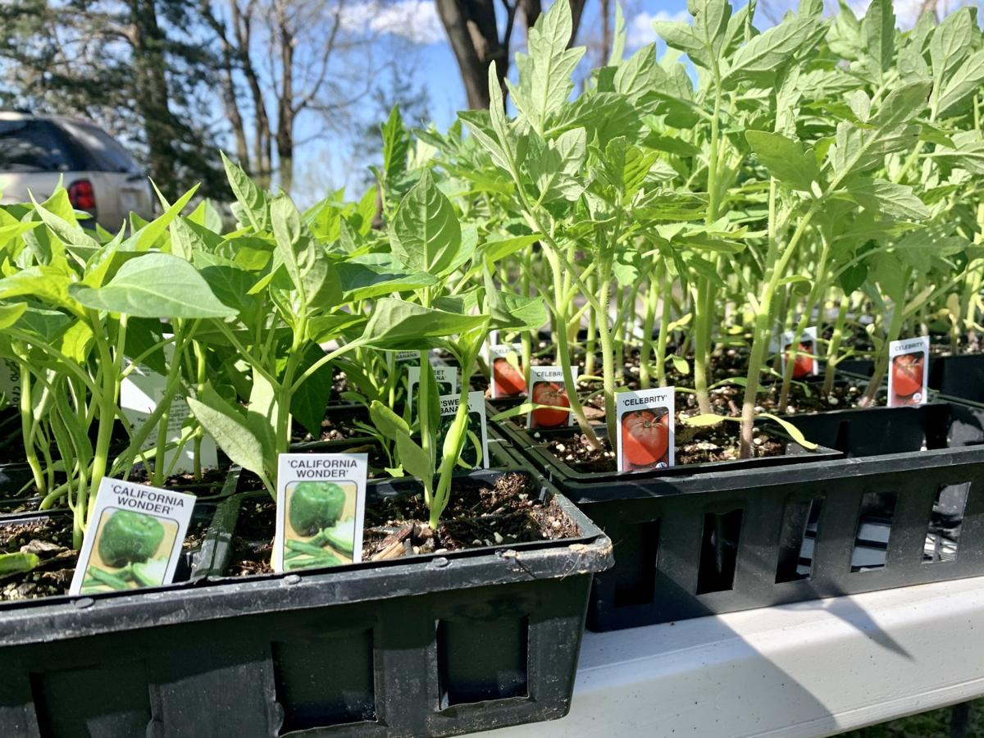
Planning Your Garden
Step 6: Decide how you will start your crops.
  You can buy seeds or young plants.
Step 7: Visit the plot of land where your garden will be located and decide what you need to do to prepare the ground.

Slide 47
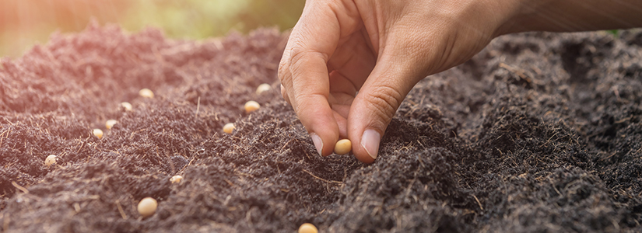
Growing from Seeds
Planting seeds into the soil outdoors is called direct sowing, and it's an easy process that yields great results.
Unlike indoor seed starting, direct sowing involves unpredictable elements: weather, wildlife and insects.
Even so, many vegetables, annuals, herbs and perennials sprout easily from seed sown directly into garden soil.

Slide 48
Growing from Seeds
Step by Step Instructions for Direct Sowing
Prepare Soil – Use a rake or hand fork to loosen soil. Break apart large soil clumps, and remove debris, such as sticks, rocks and roots. Add amendments to soil, such as fertilizer and organic matter, to create the most ideal growing situation. Finish by creating a level surface.
Dig In – Most seed packets describe planting depth. The rule of thumb is to plant at a depth equal to three times the seed diameter.
  If your soil has a high clay content and tends to crust over as it dries, cover seeds with commercial seed-starting mix.
  When sowing extremely small seeds, such as carrots, mix seeds with sand to aid in dispersal.
  When sowing larger seeds, including peas and beans, create a long furrow and dribble seeds at the proper spacing. Alternatively, use a bamboo stake, dibber or pencil to form individual planting holes.

Slide 49
Growing from Seeds
Moisture Matters – After planting, water seeds with a gentle mist or shower. Avoid using a strong splash or spray, which can dislodge seeds. It's vital to keep soil consistently moist. In a sunny spot, this may mean watering twice a day.
Stake The Spot – Mark planting areas, especially if they're tucked between existing plantings. Use garden markers, stakes and string, tall sticks, plastic cutlery — anything that clearly defines where seeds are buried.
Identify Seedlings – Learn what your seedlings will look like so you don't mistakenly pull them as weeds. Some seed packets show seedling appearance; you can also find illustrations or photos online. When in doubt, let the seedling remain until you know for sure if it's friend or foe.
Thin Seedlings – Thin seedlings as directed on the seed packet. You'll disturb roots less if, instead of pulling seedlings you're removing, you snip seedlings at the soil line with a fingernail or a tiny pair or snips or scissors.
Watch For Pests – Keep an eye out for and protect seedlings against Slugs, Snails, Cutworms and other insect pests.

Slide 50
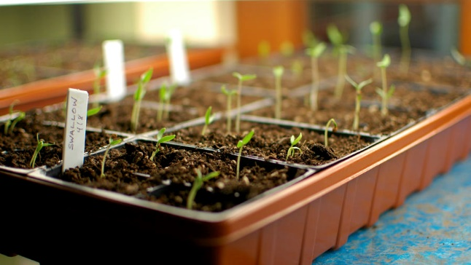
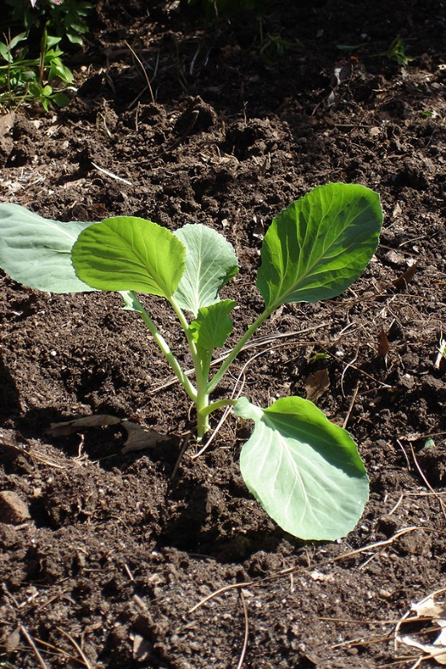
Growing from Seedlings
Your garden has a better chance of surviving outdoors if you plant seedlings that already have roots.
You can purchase seedlings or start your garden by planting seeds indoors in seed trays or small pots.
  Fill containers with soil to within ½ inch of the top.
  Place one or two seeds in each container and lightly cover the seeds with more soil.
  After the seeds have been planted, use a mist sprayer to dampen the soil.
  Place the seeds in a warm, well-lighted location.
  Keep the soil moist.
  Most seeds will sprout within 7 to 10 days.
Start four to eight weeks before your area’s last frost date.
Plants are ready to set out when they have at least four leaves and remain standing when you water them.

Slide 51
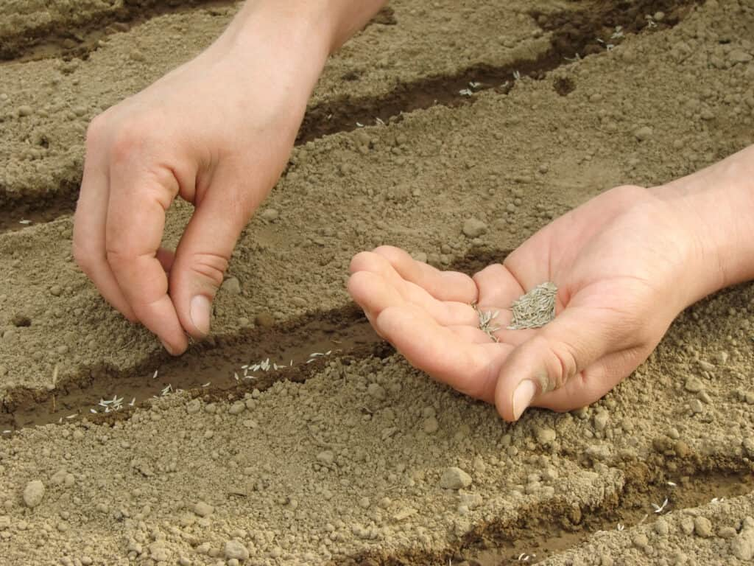
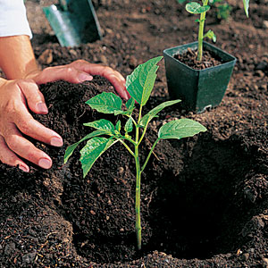
Growing Vegetables
Vegetables
Direct-sow tap-rooted vegetables, such as carrots or radishes, that don't transplant well as seedlings.
  Beets transplant well, but they prefer growing in cool soil so there's no reason to start them indoors.
Heat-loving crops that need a long season to produce, such as tomato, pepper or eggplant, don't yield as strong a performance when they're direct-sown, especially in regions with short growing seasons.
  Start these seeds indoors.
Other heat-loving crops, such as pumpkin, squash, cucumber, beans and melons, thrive when direct-sown after all danger of frost is past.

Slide 52
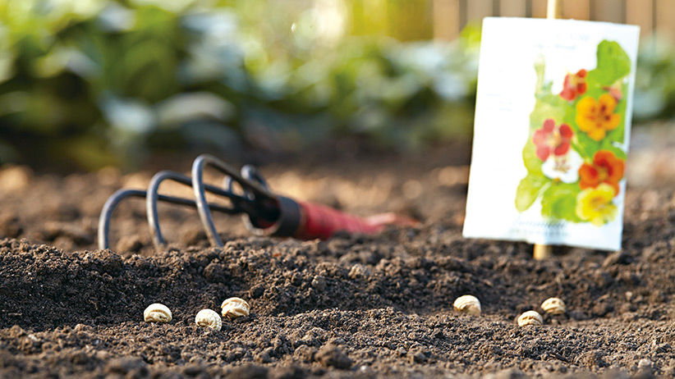

Growing Flowers
Flowers
Some flowers, including Sweet Pea, Larkspur and Bachelor's Buttons, germinate best in cool soil and should be direct-sown early in the growing season.
You also want to direct-sow bloomers that don't transplant well as seedlings, such as Morning Glory, Nasturtium, Poppies and Moonflower.
Annuals that require a long time to grow from seed are best started indoors.
Examples include Cleome, Petunia, Nicotiana and Amaranth.
Other warm-season annuals, including Cosmos, Marigold and Zinnia, grow quickly from direct-sown seed.

Slide 53

Requirement 3
Give the nutritional value of the following:
  Three root or tuber crops.
  Three vegetables that bear above the ground.
  Three fruits.

Slide 54

Nutritional Values: Root/Tuber Crops
The main nutrient supplied by roots and tubers is dietary energy provided by carbohydrates.
The protein content is low (one to two percent).
Sweet potato, potato and yam contain some vitamin C and yellow varieties of sweet potato, and yam contain beta-carotene or vitamin A.
Roots and tubers are deficient in most other vitamins and minerals but contain significant amounts of dietary fiber.

Slide 55

Nutritional Values: Vegetables
Vegetables are low in calories and fats but contain good amounts of vitamins and minerals. All the Green-Yellow-Orange vegetables are rich sources of calcium, magnesium, potassium, iron, beta-carotene, vitamin B-complex, vitamin-C, vitamin-A, and vitamin-K.
Vegetables provide plenty of soluble dietary fiber, which helps to ward off cholesterol and fats from the body and to help in smooth bowel movements.
Vegetables contain many antioxidants that help protect the human body from diseases and cancers, and by boosting our immunity level.

Slide 56

Nutritional Values: Fruits
Fruits are low in calories and fat and are a source of simple sugars, fiber, and vitamins, which are essential for optimizing our health.
Fruits provide plenty of soluble dietary fiber, which helps to ward off cholesterol and fats from the body and to help in smooth bowel movements as well as offer relief from constipation ailments.
Fruits contain many antioxidants such as vitamin-C and anthocyanins that help protect the human body from diseases and cancers, and by boosting our immunity level.

Slide 57

Requirement 4
Test 100 garden seeds for germination. Determine the percentage of seeds that germinate. Explain why you think some did not germinate.

Slide 58

Germination Test
Count out a 100 seeds, place them on absorbent paper spaced about a centimeter apart,
Place absorbent paper over the seeds, wet it lightly, and then roll it up.
Place paper towel in plastic bag, or on plate covered with plastic. Do not air seal bag shut as you need some air for healthy germination.
Put bag in a warm spot (for example, on top of your fridge).
Check daily to make sure towel does not dry out.
Most seeds will germinate within 3-10 days. Some flowers and herbs may take longer and have special germination requirements. There is a great deal of specific germination info listed online - do a simple Google search for “germination requirements for ___”
Check seeds every few days, and monitor seed quality and germination rate. Healthy seeds have uniform germination and will not have any fungal or bacterial growth on outside of seed coat.
the number of seeds sprouted out of the 100 seeds is the germination rate as a percent.
If your germination rate is less than 60%, consider buying new seeds or sowing your seeds extra thickly to compensate for the low germination rate.

Slide 59
Key Factors in Germination
  If you have poor germination rates, this may be because you have not provided enough water for these processes to take place. If the soil in your seed trays, containers or planting areas is too dry, you should be able to see or feel this fairly easily.
  Overwatering is one of the leading causes for poor, patchy or non-existent germination. Watering too much can cause waterlogging which prevents the seeds from getting enough oxygen.
  Seeds will generally germinate only within a certain temperature range. They will not germinate at all out of this temperature range, and at the extremities of the temperature range, germination rates may be significantly reduced.
  An overly humid environment can also make it more likely that you will have a problem with damping off. If your seedlings germinated, but perhaps patchily, and soon after wilted and died, you may be experiencing a problem called ‘damping off’. Damping off is caused by a number of different soil fungi that attack the seedlings just after germination and cause them to collapse and decay. You may see a white mold around affected seedlings, which is a give away that this is the problem.

Slide 60

Requirement 5
Visit your county extension agent’s office, local university, agricultural college, nursery, farm, or a botanical garden or arboretum. Report on what you learned.

Slide 61


County Extension Office
Wood County Extension Office
639 S. Dunbridge Rd., Suite 1
Bowling Green, OH 43402
Phone: 419-354-9050
ball.2129@osu.edu

Slide 62

Agricultural Colleges
Ohio State University-Main Campus
Columbus, OH
Ohio State University-Main Campus offers 30 Agriculture degree programs. It's a very large, public, four-year university in a large city. In 2019, 772 Agriculture students graduated with students earning 671 Bachelor's degrees, 59 Master's degrees, 40 Doctoral degrees, and 2 Certificates.

Slide 63

Agricultural Colleges
The University of Findlay
Findlay, OH
The University of Findlay offers 3 Agriculture degree programs. It's a small, private not-for-profit, four-year university in a faraway town. In 2019, 103 Agriculture students graduated with students earning 90 Bachelor's degrees, and 13 Associate's degrees.

Slide 64

Agricultural Colleges
Bowling Green State University-Main Campus
Bowling Green, OH
Bowling Green State University-Main Campus offers 2 Agriculture degree programs. It's a large, public, four-year university in a outlying town. In 2019, 60 Agriculture students graduated with students earning 60 Bachelor's degrees

Slide 65


Area Nurseries
North Branch Nurseries
3359 Kesson Rd.
Pemberville, OH 43450
Phone: 419-287-4679
Bostdorff Greenhouse Acres Ltd.
18862 N. Dixie Hwy.
Bowling Green, OH, 43402
Phone: 419-353-7858

Slide 66

Botanical Garden/Arboretum
Toledo Botanical Garden
5403 Elmer Drive
Toledo, Ohio 43615
(419) 407-9810

Slide 67

Botanical Garden/Arboretum
Schedel Arboretum and Gardens
19255 West Portage River South Rd
Elmore, OH 43416
419-862-3182

Slide 68

Requirement 6
Explain to your counselor how and why honeybees are used in pollinating food crops and the problems that face the bee population today. Discuss what the impact to humanity would be if there were no pollinators.

Slide 69

The Importance of Bees
The most important thing that bees do is pollinate.
Pollination is needed for plants to reproduce, and so many plants depend on bees or other insects as pollinators.
When a bee collects nectar and pollen from the flower of a plant, some pollen from the stamens—the male reproductive organ of the flower—sticks to the hairs of her body.
When she visits the next flower, some of this pollen is rubbed off onto the stigma, or tip of the pistil—the female reproductive organ of the flower.
When this happens, fertilization is possible, and a fruit, carrying seeds, can develop.

Slide 70


The Importance of Bees
Up until about one hundred years ago, there were enough wild bees and other insects in the world to pollinate virtually all of the food crops being planted.
Today, however, because of intensive agricultural practices, and a sharp decline in the number of wild bees due to the use of chemicals, pollution, and destruction of insect habitat, there simply are not nearly enough wild insect pollinators to effectively pollinate our crops.
As a result, the business of honeybee pollination services has developed throughout many parts of the world, where a beekeeper can rent a colony of honeybees to a farmer for the bloom season, which is typically 4 weeks long.

Slide 71

The Importance of Bees
Of the world’s 115 most important food crops, 87 require bee pollination to produce fruits, nuts and seeds and they account for a third of the $3 trillion worth of agricultural produce sold each year.
These crops provide 35% of the calories we consume yearly and most of the vitamins, minerals and antioxidants.
Seven of the nine crops that provide at least half the vitamin C to the human diet depend on insect pollination and they include oranges, cabbages, peppers, tomatoes, melons, tangerines and watermelons.
Five major fruit crops (apple, almond, avocado, blueberry and cranberry) are reliant on insect pollination.

Slide 72


Problems Honey Bees Face
Colony Collapse Disorder (CCD) - CCD has been defined as a series of symptoms, but the cause and the cure have remained complex and elusive.
The Varroa mite (Varroa destructor) - is an external parasite that has spread from its original host, the Asian honey bee Apis cerana, to nearly all Western honey bees (Apis mellifera) worldwide. Virtually all European honey bees are highly vulnerable to Varroa mites.

Slide 73


Problems Honey Bees Face
Nosema ceranae - This microscopic fungus can weaken or even kill colonies when the majority of workers become infected. Spores of the fungus survive on wax combs and stored food inside colonies. When workers eat these spores the fungus invades the lining of the intestine. Highly infected bees cannot digest efficiently and die earlier.
American foulbrood (Paenibacillus larvae) - is an infection that kills young bees (brood) inside the wax cells in which they develop. This dead brood becomes a source of infection spread by workers nursing young brood.

Slide 74

Problems Honey Bees Face
Pesticides - Some insecticides are toxic to honey bees, causing honey bee deaths.
Habitat Loss and Fragmentation - Bees need big spaces with lots of flowers for food, as well as safe and undisturbed areas for their nests. In the winter, they need places that are protected from the wind and cold. Unfortunately, development of wild spaces is causing problems for bees. When wildflowers disappear, bees that are active in early spring have a hard time getting enough food to eat, and it can make it difficult for the queen to start her colony.
Climate Change - Scientists believe that climate change is also impacting bees. Climate change is bringing on extreme weather events which can affect the timing of when flowers start to bloom. Fewer flowers available in the early spring mean less food for bees.

Slide 75

What would happen if bees went extinct?
We may lose all the plants that bees pollinate, all of the animals that eat those plants and so on up the food chain.
Which means a world without bees could struggle to sustain the global human population of 7 billion.
Our supermarkets would have half the amount of fruit and vegetables.

Slide 76

Requirement 7
Identify five garden pests (insects, diseased plants). Recommend two solutions for each pest. At least one of the two solutions must be an organic method.

Slide 77

Insecticide Control of Insect Pests
Sevin insecticide is a "nonsystemic" insecticides for controlling pests.
This means it doesn't penetrate vegetables or plant tissues.
It kills insects by contact.
You can treat tomatoes and many other garden favorites right up to one day before harvest.
Just follow label directions and guidelines for intervals between application and your harvest day.

Slide 78


Cabbage Worm
Holes in cabbage leaves are a telltale sign of cabbage worm feeding.
Hand-remove adults and look for eggs on the undersides of the leaves.

Slide 79

Tomato Hornworm
The tomato hornworm is the larval stage of the five-spotted hawk moth.
Hornworms favor the leaves of tomato and pepper plants.
Because the hornworm is so large, the easiest way to get rid of it is to simply remove it from the plant and dispose of it.

Slide 80



Whiteflies, Aphid, and Mealybugs
These insects feed off plants by sucking the plant's juices and can cause wilting, stunting, and death.﻿
Populations can grow quickly and the best way to control these pests is to constantly monitor for them and use a combination of techniques to keep their population down.
Check to be sure any new plant you buy is not infested.
If you discover a small infestation in your garden, wash it off with a blast of water from the hose or by sinking the plant into a bucket of water.
Organic controls include sprays containing pyrethrum or insecticidal soap. Repeated sprayings will probably be necessary to control existing infestations. Coat both the upper and lower surfaces of leaves.

Slide 81


Cucumber Beetles
Cucumber beetles eat roots, leaves, and flowers and transmit bacterial wilt disease along the way. The damage usually isn’t enough to kill the plants, but the loss of flowers means a loss of fruits. The spread of bacterial wilt can be deadly and quick. It starts with one leaf wilting and spreads. A telltale sign of bacterial wilt is the sticky, white sap-like substance that oozes from snapped stems. Bacterial wilt is a serious disease of cucumbers and muskmelons. It affects squash, too, but to a much lesser extent.
Control the damage done by cucumber beetles by buying wilt-resistant plants and keeping plants off the ground by using a trellis. If an infestation still occurs, use a pesticide such as Rotenone or Pyrethrum on your plants. Cucumber plants are sensitive to many chemicals, so follow the label’s instructions carefully and use chemicals only as a last resort.

Slide 82

Powdery Mildew
There are many different species of powdery mildew, and each species attacks a range of different plants. Commonly affected plants include squash, pumpkins, cucumbers, melons, tomatoes, eggplants, peppers, beans, and peas.
Consider spraying infected plants with protectant (preventative) fungicides. Effective organic fungicides for treating powdery mildew include sulfur, lime-sulfur, neem oil, and potassium bicarbonate. These are most effective when used prior to infection or when you first see signs of the disease.
If you don’t want to use chemical fungicides, try spraying your plants with a bicarbonate solution:
  Mix 1 teaspoon baking soda in 1 quart of water. Spray plants thoroughly, as the solution will only kill fungus that it comes into contact with.

Slide 83

Mosaic Virus
Mottled yellow leaves usually indicate a mosaic virus.
Remove and destroy any affected plants as soon as possible to limit the spread of the virus.

Slide 84

Leaf Spot
The lower leaves of this tomato plant are infected with leaf spot.
A fungicide can be used and the leaves can be removed from the lower part of the plant to prevent spores from splashing up onto the foliage.

Slide 85
Requirement 8
Do ONE of the following and record weekly observations. Discuss the results of your project with your counselor:
  Build a compost bin and maintain it for 90 days.
  Build a vermipost bin (worm compost bin) and maintain it for 90 days.
  Build a hydroponic garden containing three vegetables or herbs, or three ornamental plants. Maintain this garden through harvest or flowering, or for 90 days.
  Build one water garden, either in a container (at least 12 by 6 inches and 6 inches deep), or in the ground as a small, decorative pond no larger than 6 by 3 feet and 24 inches deep. Maintain the water garden for 90 days.
  Prepare a honey super for use on a hive or colony. Remove a filled honey super from the hive or colony and prepare the honey for sale.
  Grow a garden of your own using soil from seed or plantings to harvest or for 90 days, whichever is earlier. This can be an outdoor garden or indoors using appropriate containers, and should include at least three types of plants approved by your counselor.

Slide 86

Compost Bin
Click on the following link for an instructional video on How to build a compost bin with pallets
Download the document on 7 Easy Steps to Composting

Slide 87
Requirement 8
Do ONE of the following and record weekly observations. Discuss the results of your project with your counselor:
  Build a compost bin and maintain it for 90 days.
  Build a vermipost bin (worm compost bin) and maintain it for 90 days.
  Build a hydroponic garden containing three vegetables or herbs, or three ornamental plants. Maintain this garden through harvest or flowering, or for 90 days.
  Build one water garden, either in a container (at least 12 by 6 inches and 6 inches deep), or in the ground as a small, decorative pond no larger than 6 by 3 feet and 24 inches deep. Maintain the water garden for 90 days.
  Prepare a honey super for use on a hive or colony. Remove a filled honey super from the hive or colony and prepare the honey for sale.
  Grow a garden of your own using soil from seed or plantings to harvest or for 90 days, whichever is earlier. This can be an outdoor garden or indoors using appropriate containers, and should include at least three types of plants approved by your counselor.

Slide 88

Vermipost Bin
Click on the following link for an instructional video on How to Make a Worm Composting Bin

Slide 89
Requirement 8
Do ONE of the following and record weekly observations. Discuss the results of your project with your counselor:
  Build a compost bin and maintain it for 90 days.
  Build a vermipost bin (worm compost bin) and maintain it for 90 days.
  Build a hydroponic garden containing three vegetables or herbs, or three ornamental plants. Maintain this garden through harvest or flowering, or for 90 days.
  Build one water garden, either in a container (at least 12 by 6 inches and 6 inches deep), or in the ground as a small, decorative pond no larger than 6 by 3 feet and 24 inches deep. Maintain the water garden for 90 days.
  Prepare a honey super for use on a hive or colony. Remove a filled honey super from the hive or colony and prepare the honey for sale.
  Grow a garden of your own using soil from seed or plantings to harvest or for 90 days, whichever is earlier. This can be an outdoor garden or indoors using appropriate containers, and should include at least three types of plants approved by your counselor.

Slide 90

Hydroponic Gardening
Click on the following link for an instructional video on How to Build an Inexpensive Hydroponics Garden.

Slide 91
Requirement 8
Do ONE of the following and record weekly observations. Discuss the results of your project with your counselor:
  Build a compost bin and maintain it for 90 days.
  Build a vermipost bin (worm compost bin) and maintain it for 90 days.
  Build a hydroponic garden containing three vegetables or herbs, or three ornamental plants. Maintain this garden through harvest or flowering, or for 90 days.
  Build one water garden, either in a container (at least 12 by 6 inches and 6 inches deep), or in the ground as a small, decorative pond no larger than 6 by 3 feet and 24 inches deep. Maintain the water garden for 90 days.
  Prepare a honey super for use on a hive or colony. Remove a filled honey super from the hive or colony and prepare the honey for sale.
  Grow a garden of your own using soil from seed or plantings to harvest or for 90 days, whichever is earlier. This can be an outdoor garden or indoors using appropriate containers, and should include at least three types of plants approved by your counselor.

Slide 92

Water Gardens
Click on the following link for an instructional video on Building a Container Water Garden.

Slide 93
Requirement 8
Do ONE of the following and record weekly observations. Discuss the results of your project with your counselor:
  Build a compost bin and maintain it for 90 days.
  Build a vermipost bin (worm compost bin) and maintain it for 90 days.
  Build a hydroponic garden containing three vegetables or herbs, or three ornamental plants. Maintain this garden through harvest or flowering, or for 90 days.
  Build one water garden, either in a container (at least 12 by 6 inches and 6 inches deep), or in the ground as a small, decorative pond no larger than 6 by 3 feet and 24 inches deep. Maintain the water garden for 90 days.
  Prepare a honey super for use on a hive or colony. Remove a filled honey super from the hive or colony and prepare the honey for sale.
  Grow a garden of your own using soil from seed or plantings to harvest or for 90 days, whichever is earlier. This can be an outdoor garden or indoors using appropriate containers, and should include at least three types of plants approved by your counselor.

Slide 94

Honey Bees
The best way to find your local beekeepers is to get online, visit your favorite search engine and type in your zip code, county name, or city name and the phrase “beekeepers association” into the search.
For Wood County, Ohio, Contact the Maumee Valley Beekeepers Association for help in finding a local beekeeper to do this requirement.

Slide 95
Requirement 8
Do ONE of the following and record weekly observations. Discuss the results of your project with your counselor:
  Build a compost bin and maintain it for 90 days.
  Build a vermipost bin (worm compost bin) and maintain it for 90 days.
  Build a hydroponic garden containing three vegetables or herbs, or three ornamental plants. Maintain this garden through harvest or flowering, or for 90 days.
  Build one water garden, either in a container (at least 12 by 6 inches and 6 inches deep), or in the ground as a small, decorative pond no larger than 6 by 3 feet and 24 inches deep. Maintain the water garden for 90 days.
  Prepare a honey super for use on a hive or colony. Remove a filled honey super from the hive or colony and prepare the honey for sale.
  Grow a garden of your own using soil from seed or plantings to harvest or for 90 days, whichever is earlier. This can be an outdoor garden or indoors using appropriate containers, and should include at least three types of plants approved by your counselor.

Slide 96

Growing a Garden
To grow a garden for the Gardening Merit Badge, follow these steps:
Step 1: Choose Your Garden Type
  Outdoor Garden: If you have space, choose a sunny spot with good soil and drainage.
  Indoor Garden: Use containers with drainage holes and place them near a sunny window or use grow lights.

Slide 97

Growing a Garden
Step 2: Select Your Plants
  Choose at least three types of plants that grow well in your climate and season. Some good options include:
  Vegetables: Tomatoes, lettuce, radishes, beans, or peppers.
  Herbs: Basil, mint, chives, or parsley.
  Flowers: Marigolds, petunias, or zinnias (attract pollinators).

Slide 98


Growing a Garden
Step 3: Prepare the Soil
  Outdoor Garden: Loosen the soil with a shovel and mix in compost or organic matter.
  Indoor Garden: Use potting soil with nutrients and good drainage.

Slide 99

Growing a Garden
Step 4: Planting
  Seeds: Follow the depth and spacing instructions on seed packets.
  Seedlings (Plant Starts): Dig a small hole, place the plant, and cover the roots with soil.

Slide 100


Growing a Garden
Step 5: Water and Care for Your Garden
  Water: Keep the soil moist but not soggy. Water early in the morning.
  Sunlight: Most plants need 6–8 hours of sunlight daily.
  Weeding: Remove weeds regularly to prevent them from competing for nutrients.
  Support: Use stakes or trellises for plants like tomatoes or beans.

Slide 101


Growing a Garden
Step 6: Monitor Growth and Prevent Pests
  Check leaves for signs of disease or bugs. Use organic pest control if needed.
  Fertilize as needed using compost or store-bought plant food.

Slide 102

Growing a Garden
Step 7: Harvest Your Crops
  Vegetables: Harvest when ripe for the best taste.
  Herbs: Snip leaves as needed; they grow back.
  Flowers: Pick blooms regularly to encourage more growth.

Slide 103
Requirement 9
Do ONE of the following:
  Identify three career opportunities that would use skills and knowledge in gardening. Pick one and research the training, education, certification requirements, experience, and expenses associated with entering the field. Research the prospects for employment, starting salary, advancement opportunities and career goals associated with this career. Discuss what you learned with your counselor and whether you might be interested in this career.
  Identify how you might use the skills and knowledge in gardening to pursue a personal hobby and/or healthy lifestyle. Research the additional training required, expenses, and affiliation with organizations that would help you maximize the enjoyment and benefit you might gain from it. Discuss what you learned with your counselor and share what short-term and long-term goals you might have if you pursued this.

Slide 104

Horticulturist
Training & Education: Bachelor’s degree in horticulture, botany, or plant science.
Certification: Certified Horticulturist through the American Society for Horticultural Science (ASHS).
Experience: Internships or hands-on work in nurseries, botanical gardens, or farms.
Expenses: Tuition costs ($20,000–$50,000 for a degree); certification fees (~$200).
Employment Prospects: Strong demand in landscaping, agriculture, and botanical research.
Starting Salary: Around $40,000–$50,000 per year.
Advancement Opportunities: Can become a research scientist, greenhouse manager, or landscape designer.

Slide 105

Landscape Designer
Training & Education: Associate’s or bachelor’s degree in landscape architecture or horticulture.
Certification: Optional certification from the Association of Professional Landscape Designers (APLD).
Experience: Experience in landscaping projects, internships, or apprenticeships.
Expenses: Tuition costs ($10,000–$60,000 for a degree); certification fees ($200–$500).
Employment Prospects: Steady demand due to residential and commercial landscaping needs.
Starting Salary: Around $45,000 per year.
Advancement Opportunities: Can become a senior landscape architect or start a landscaping business.

Slide 106

Arborist (Tree Care Specialist)
Training & Education: Associate’s or bachelor’s degree in forestry, arboriculture, or horticulture.
Certification: Certified Arborist credential from the International Society of Arboriculture (ISA).
Experience: On-the-job training, apprenticeships, or internships with tree care companies.
Expenses: Tuition costs ($10,000–$50,000 for a degree); certification fees ($100–$500).
Employment Prospects: High demand due to urban tree care needs and environmental concerns.
Starting Salary: Around $40,000–$50,000 per year.
Advancement Opportunities: Can become a lead arborist, tree consultant, or start a tree care business.

Slide 107

Greenhouse Manager
Training & Education: Associate’s or bachelor’s degree in horticulture, agriculture, or greenhouse management.
Certification: Optional certifications in greenhouse operations or hydroponics.
Experience: Experience working in nurseries, botanical gardens, or commercial greenhouses.
Expenses: Tuition costs ($10,000–$50,000 for a degree); greenhouse setup costs vary.
Employment Prospects: Good demand due to increasing interest in sustainable farming and plant cultivation.
Starting Salary: Around $40,000 per year.
Advancement Opportunities: Can advance to large-scale greenhouse operations or research positions.

Slide 108

Floral Designer
Training & Education: No formal degree required, but courses in floral design or horticulture are beneficial.
Certification: Certified Floral Designer (CFD) from the American Institute of Floral Designers (AIFD).
Experience: Hands-on experience in a flower shop, greenhouse, or floral event business.
Expenses: Floral design courses ($500–$3,000); certification fees (~$150–$500).
Employment Prospects: Steady demand in wedding, event planning, and retail flower shops.
Starting Salary: Around $30,000–$40,000 per year.
Advancement Opportunities: Can open a floral business or specialize in luxury event design.

Slide 109

Agronomist (Soil and Crop Scientist)
Training & Education: Bachelor’s degree in agronomy, soil science, or agricultural science.
Certification: Certified Crop Adviser (CCA) or Soil Scientist certification.
Experience: Hands-on work in agriculture, farming, or soil testing labs.
Expenses: Tuition costs ($30,000–$80,000 for a degree); certification fees ($200–$400).
Employment Prospects: High demand in farming, agribusiness, and environmental conservation.
Starting Salary: Around $50,000–$70,000 per year.
Advancement Opportunities: Can advance to research, consulting, or agricultural management roles.

